Slide 1
Envy Bubble Tea & Smoothies
Sean Snider, Sydney Vargas, and Joshua Treadway

Slide 2
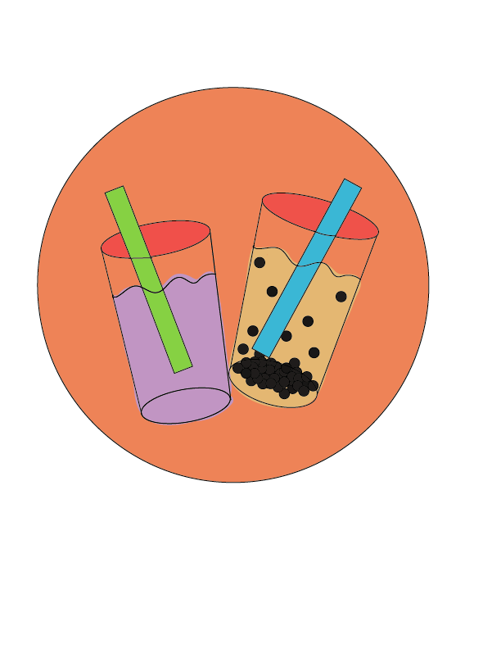
Our Business
Envy Bubble Tea & Smoothies will be serving the Phoenix area with a variety of delicious that are fresh, all natural, and vegan friendly.
The menu will consist of different flavors of bubble teas and smoothies, all made to order and customizable upon request.

Slide 3
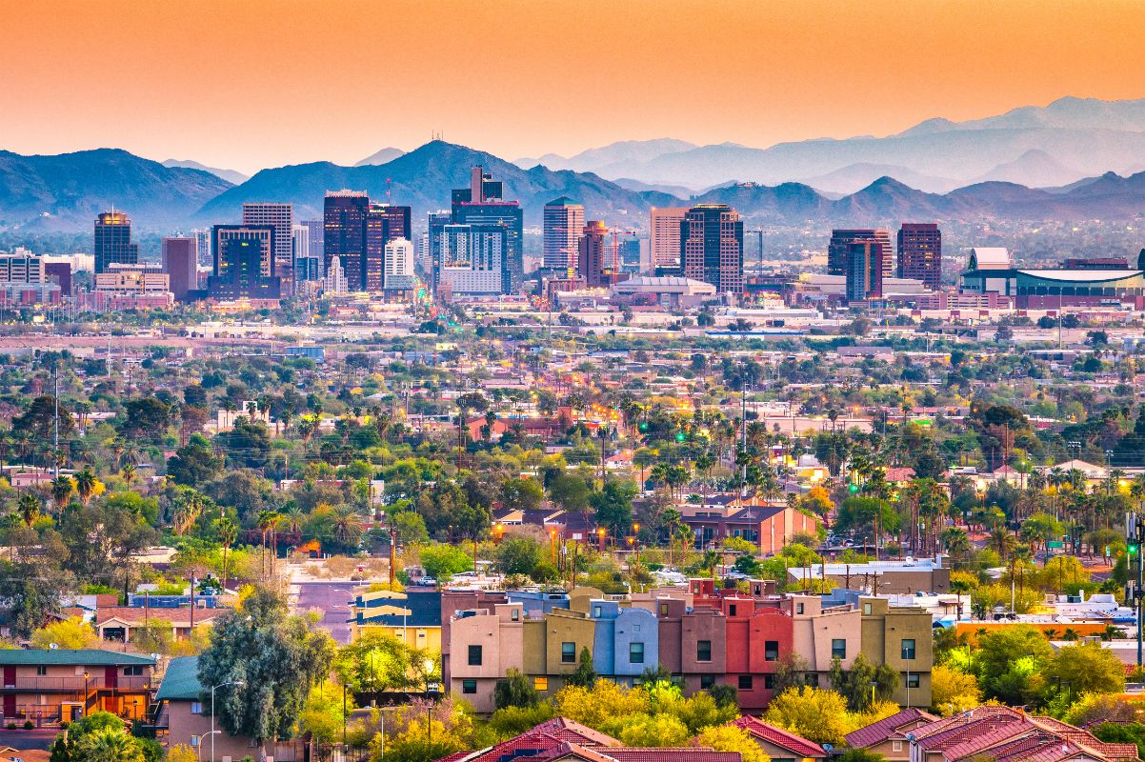
Location
We selected Phoenix, Arizona to host our Pop Up in.
The city is warm, friendly, and we believe our products fit the culture of the city.

Slide 4
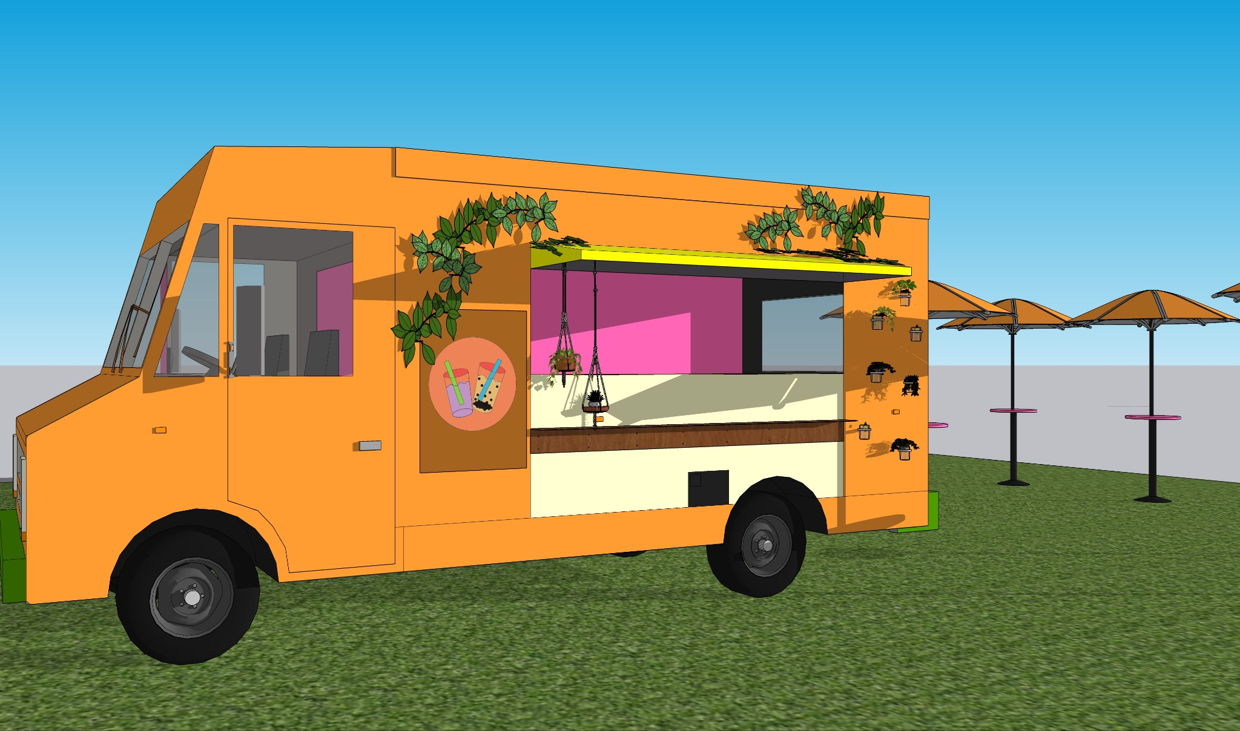
Design

Slide 5
WHy a food Truck?
A food truck is easily portable, and can set up shop in any area, but preferably in warmer weather.
A food truck is self-contained, so it is more inexpensive to operate.
Food trucks carry with them a sense of urgency to indulge, as they could leave the area soon.

Slide 6
Our color palette
We decided to do a combination of brighter and warmer colors. These colors typically make you think of warmth, summertime, and are quite refreshing to look at. When we see orange, pink, and yellow specifically, we may think of lounging in the sun with a smoothie, or other refreshing drink, and that is the experience that we wanted to bring to the customers. These colors also appeal to the younger audience we hoped to reach.

Slide 7
Accessibility
Food trucks are a bit more accessible to all people than other types of pop-ups may be. For starters, ours is in a public space, so it is easy to find and get to. We intend to have a lower serving window to help those who are in a wheelchair or are otherwise disabled. Also, the bright color of our truck makes it easy to spot for those who have trouble with their vision. Overall, our truck is widely accessible for all patrons.

Slide 8
Experience: Attraction
The customers will be attracted by the promotional tools that will be discussed later.
The color of our truck itself will be attractive to customers, as the colors and the design itself are appealing.
We hope that the area where we park the truck will already have heavy foot traffic, leading more people to our business.

Slide 9
Experience: Purchase
Our food truck will operate as most food trucks do: you order at the bar and give your name, then wait for your name to be called at the pick-up counter.
We plan to partner with Square or some other similar business so that we will be able to accept cash or card. We can also take paypal or venmo.

Slide 10
Experience: Enjoyment
Next to our food truck we have set up a few standing tables. We made sure to have them under umbrellas because of the heat and sun that we expect from Phoenix.
We also anticipate that people may want to get their refreshing beverage and be on their way.
It is our hope that wherever we set up shop, there will be ample space for customers to picnic if they so choose.

Slide 11
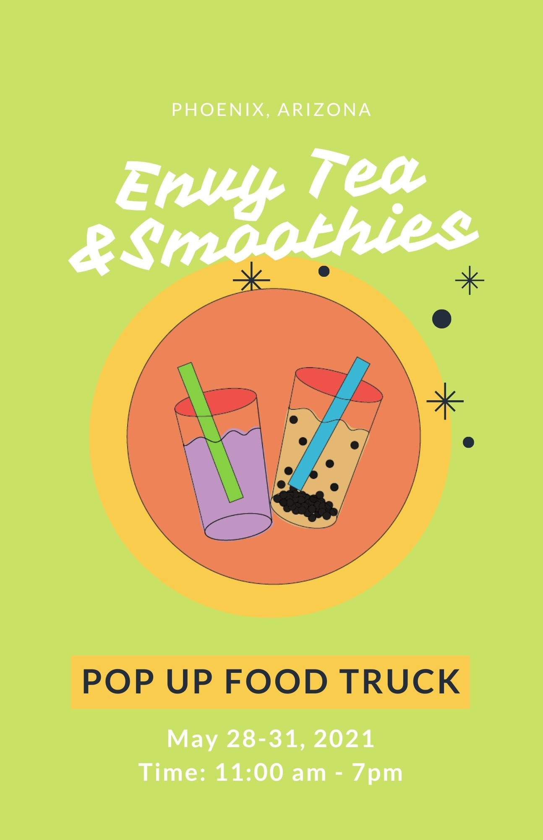
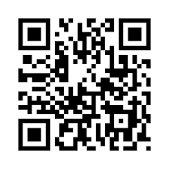
Flyers
This flyer will be distributed around Phoenix, Arizona, and posted on our several social media platforms.

Slide 12
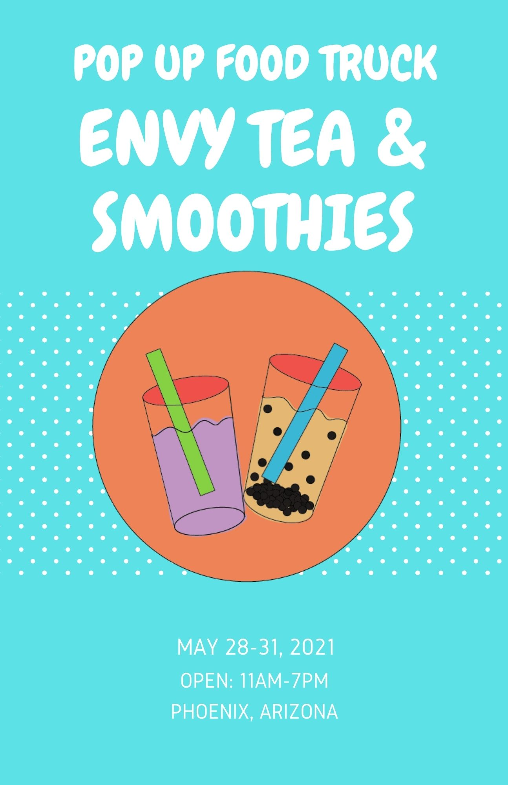
Flyers
This flyer will be distributed around Phoenix, Arizona, and posted on our several social media platforms.

Slide 13
Budget
- Our budget total came out to $9,636.
- We are able to save costs by buying ingredients in bulk and operating the social media ourselves.

Slide 14

Marketing Campaign
Envy Bubble Tea & Smoothies would have several social media platforms such as Instagram, Twitter, and Facebook.
Both Flyers that were made would be posted on these platforms to get the word out about Envy Tea & Smoothies.

Slide 15
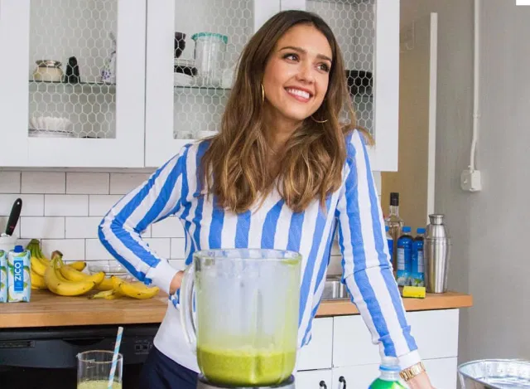
Marketing Campaign
Jessica Alba is the celebrity influencer that is going to be the spokesperson for Envy Bubble Tea & Smoothies. Jessica Alba is known to have a healthy lifestyle and is the perfect fit for our pop-up food truck. She would be posting Instagram photos and stories with our products. Since she has a big following on Instagram this would give our business a big boost for when we do open.

